Slide 1
Chapter 9 – Biomaterials discovery: Experimental and Computational approaches

Slide 2
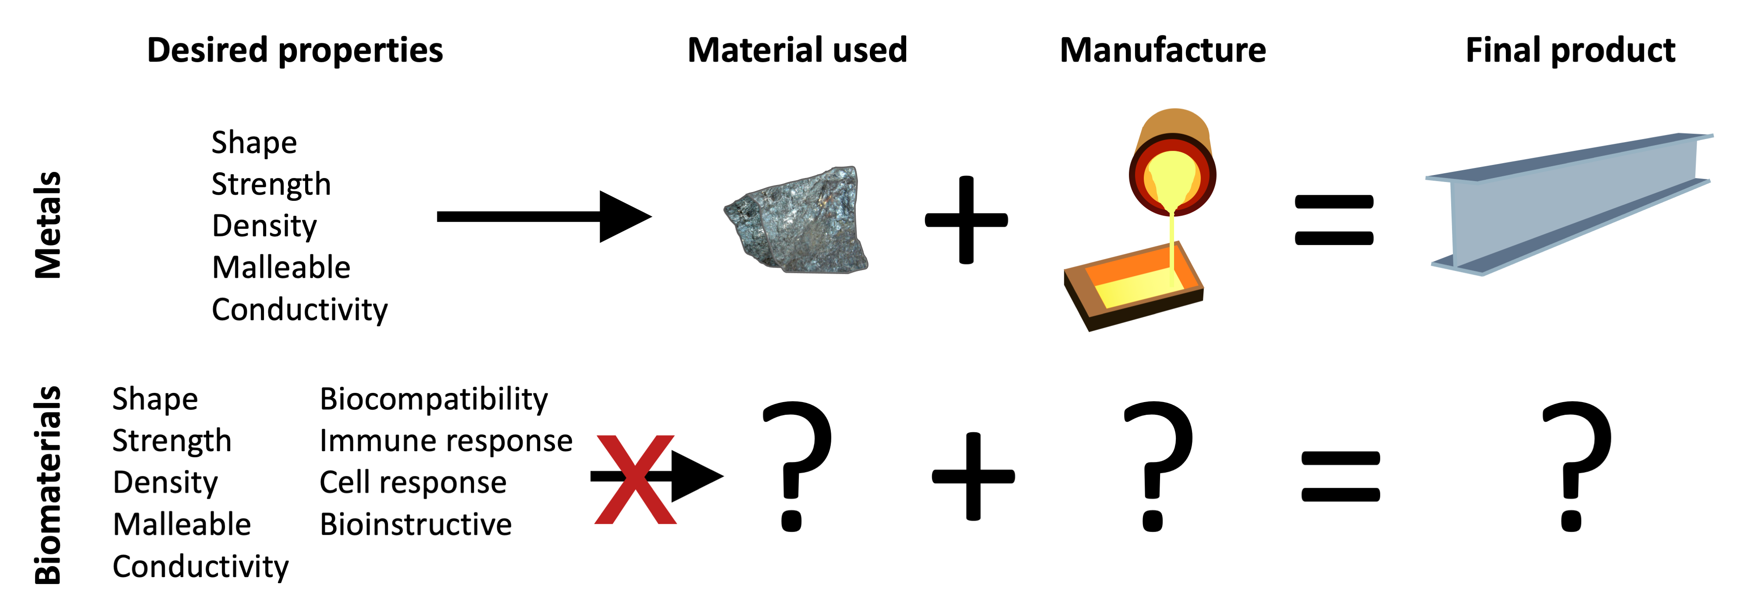
Notes:
Figure 9.1: Comparing the structure-property knowledge between mechanical engineering and biomaterials.

Slide 3
Notes:
Figure 9.2: Comparing hypothesis led and high throughput materials discovery.

Slide 4
Notes:
Figure 9.3: The key parameters that must be considered for the creation of a polymer microarray.
From Polymer microarrays for high throughput biomaterials discovery, Hook, A.L. 2014. In: Palmer, E. (ed.) Cell-Based microarrays - Review of applications, developments and technological advances, Springer, New York, USA.

Slide 5
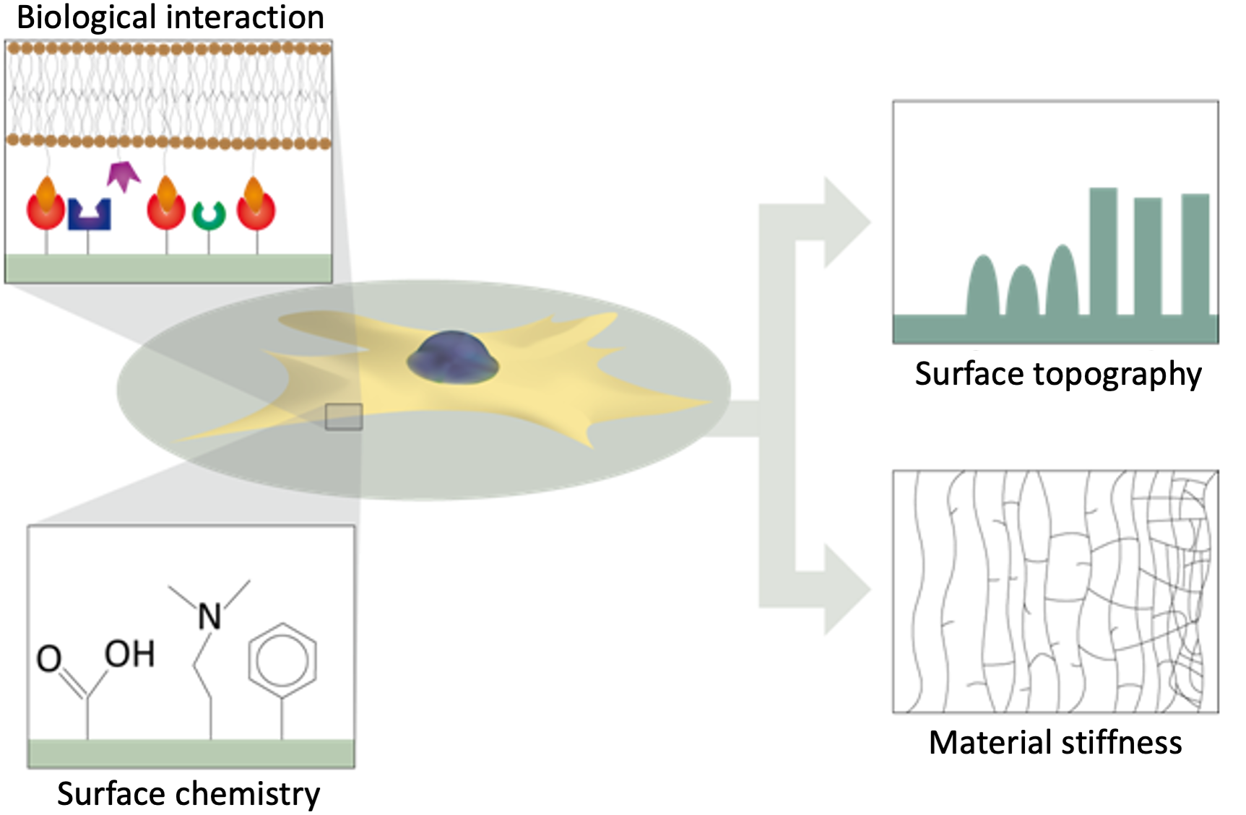
Notes:
Figure 9.4: The key aspects of biological-material interactions.
From Polymer microarrays for high throughput biomaterials discovery, Hook, A.L. 2014. In: Palmer, E. (ed.) Cell-Based microarrays - Review of applications, developments and technological advances, Springer, New York, USA.

Slide 6
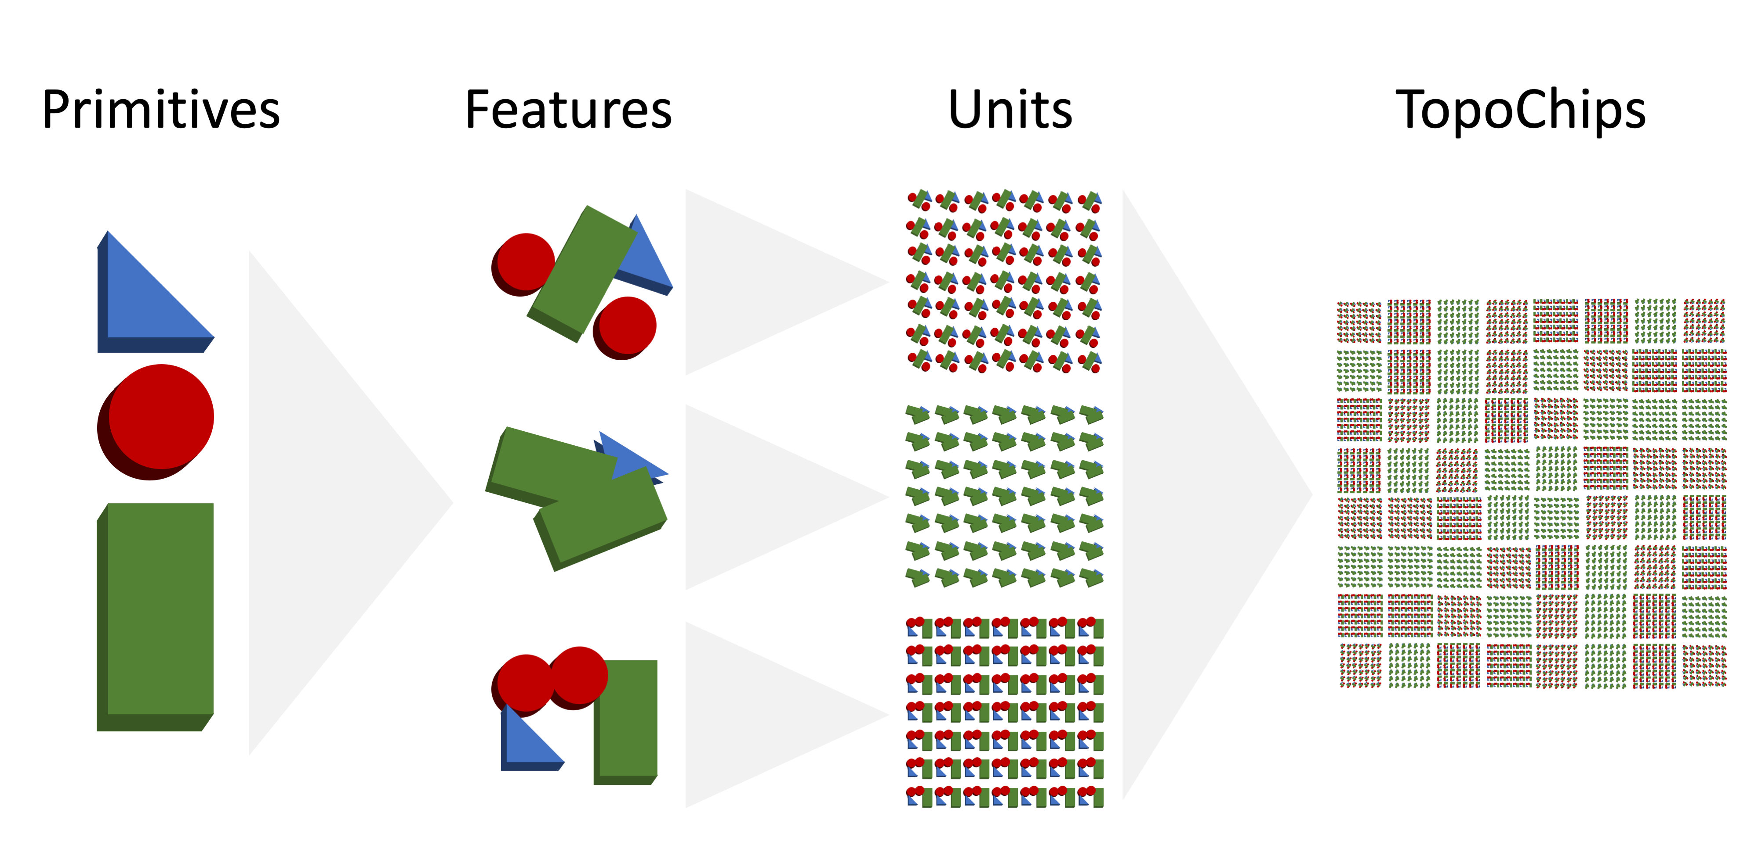
Notes:
Figure 9.5: Design of a TopoChip.
From An algorithm-based topographical biomaterials library to instruct cell fate, Unadkat et al., 2011. Proc. Natl. Acad. Sci. USA 108, 16565-16570.

Slide 7
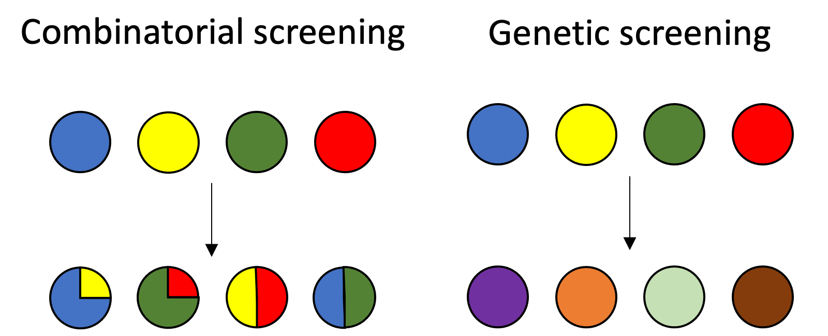
Notes:
Figure 9.6: Comparing combinatorial and genetic screening.

Slide 8
Notes:
Figure 9.7: Schematic of a multi-generation screening approach.

Slide 9
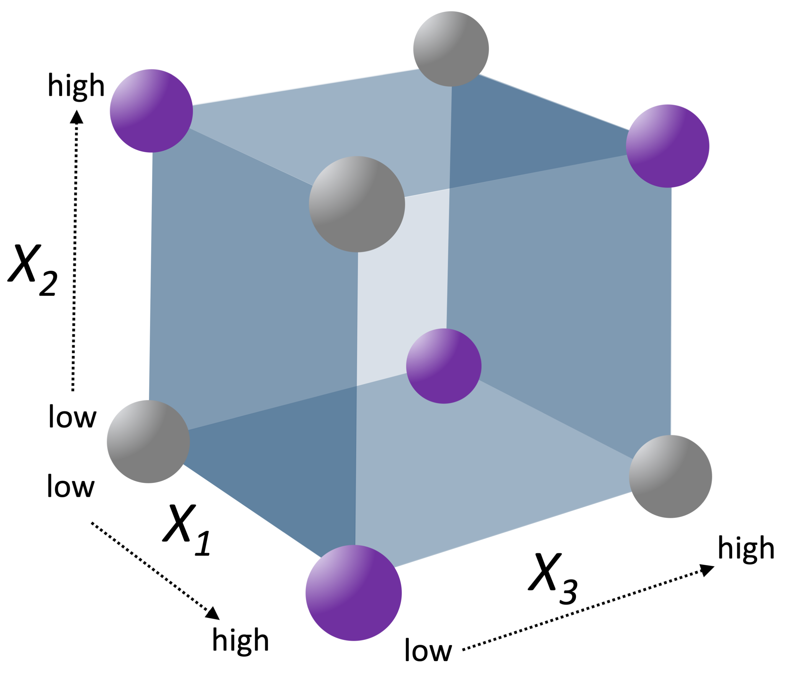
Notes:
Figure 9.8: Schematic depiction of design of experiments.

Slide 10
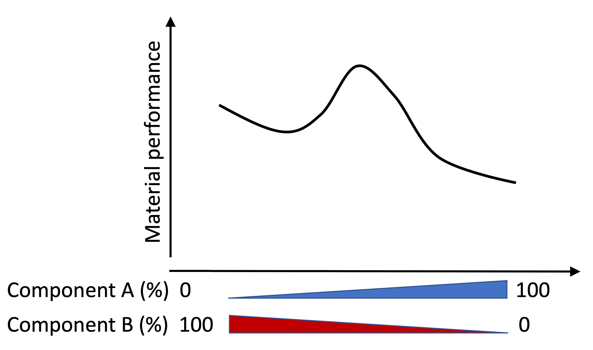
Notes:
Figure 9.9: Example of the observation of synergistic effects observed in a two-component system.

Slide 11
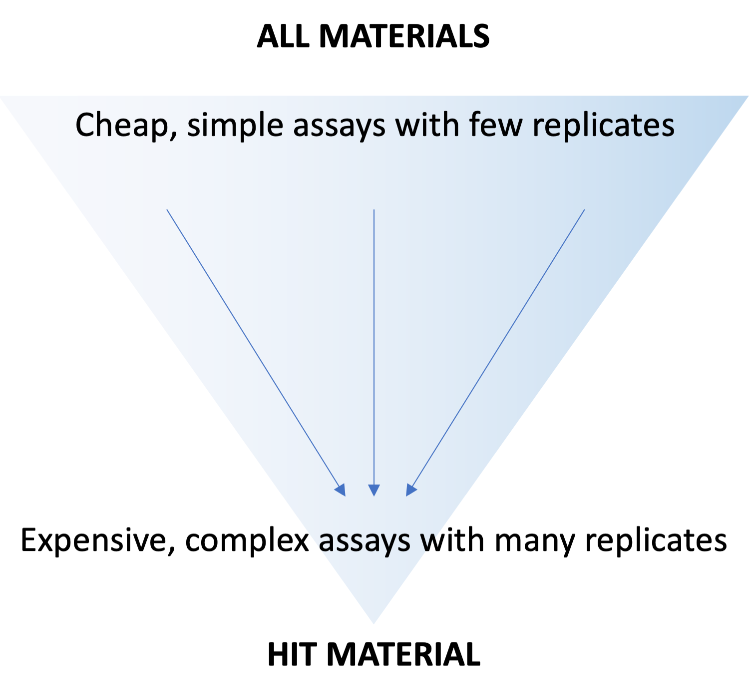
Notes:
Figure 9.10: The changing requirements of biological assays in a materials discovery project with the progression towards a hit material.

Slide 12
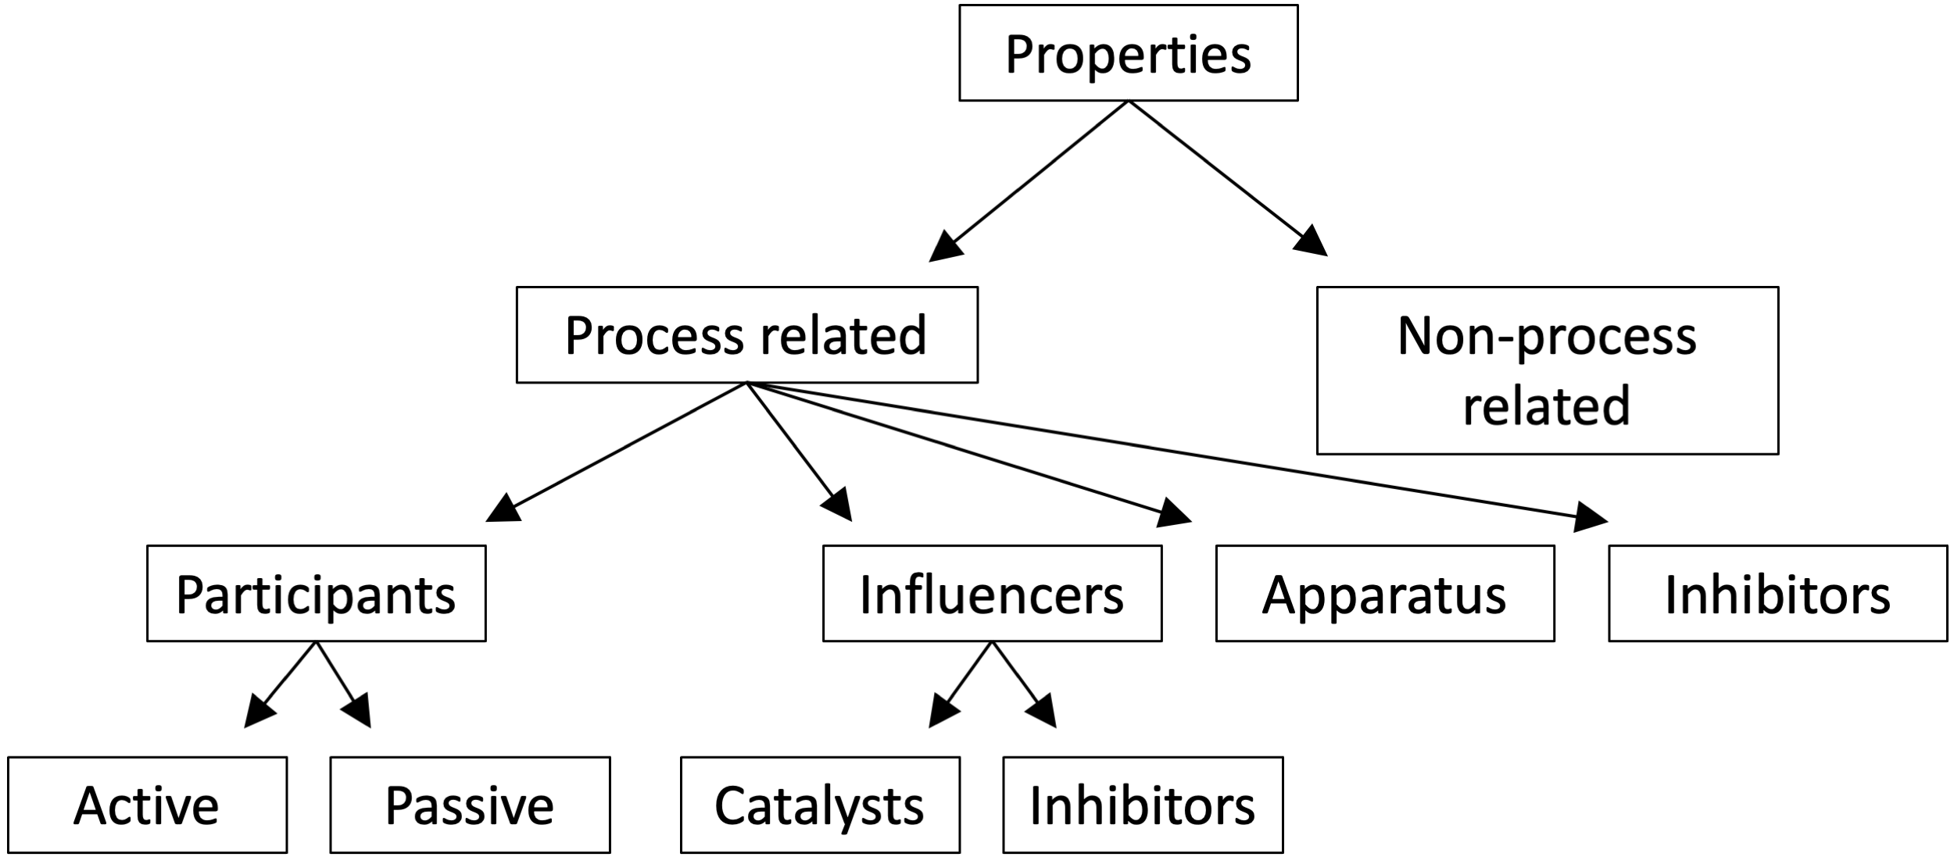
Notes:
Figure 9.11: The POLIDCASYR semantic categories.
From Polymer Informatics, Adams, N. 2010. In: Meier, M.a.R. & Webster, D.C. (eds.) Polymer Libraries, Springer.

Slide 13
Notes:
Figure 9.12: Structure of the Property Ontology.
From Polymer Informatics, Adams, N. 2010. In: Meier, M.a.R. & Webster, D.C. (eds.) Polymer Libraries, Springer.

Slide 14
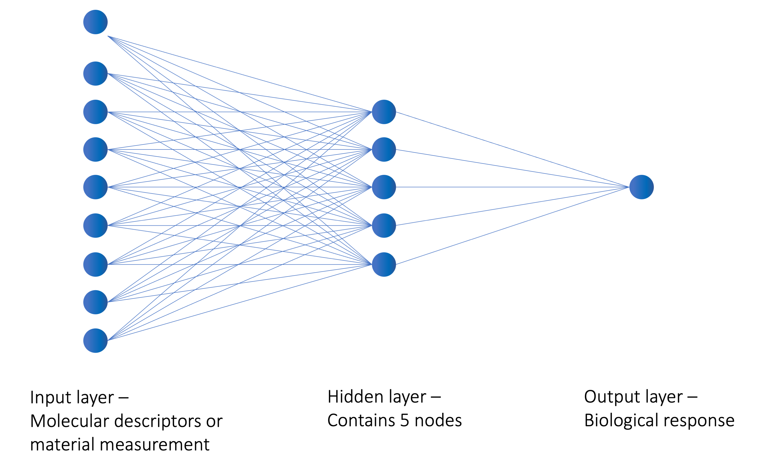
Notes:
Figure 9.13: Schematic of a neural network.

Slide 15
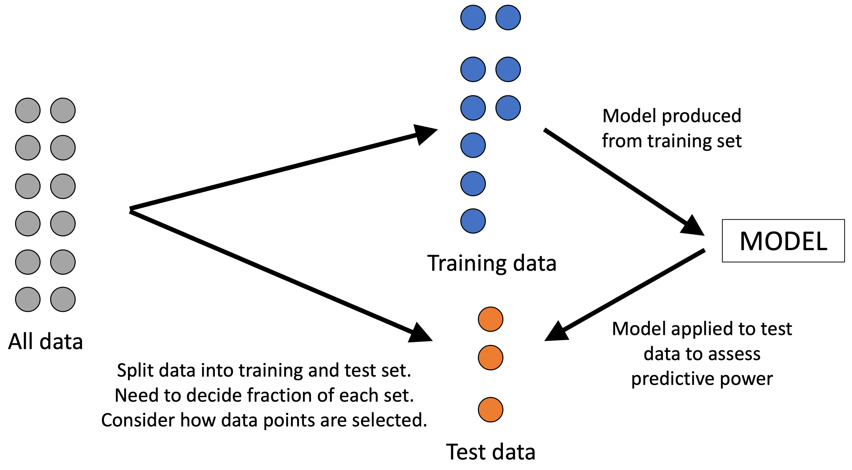
Notes:
Figure 9.14: Training/test set method to assess model predictivity.

Slide 16
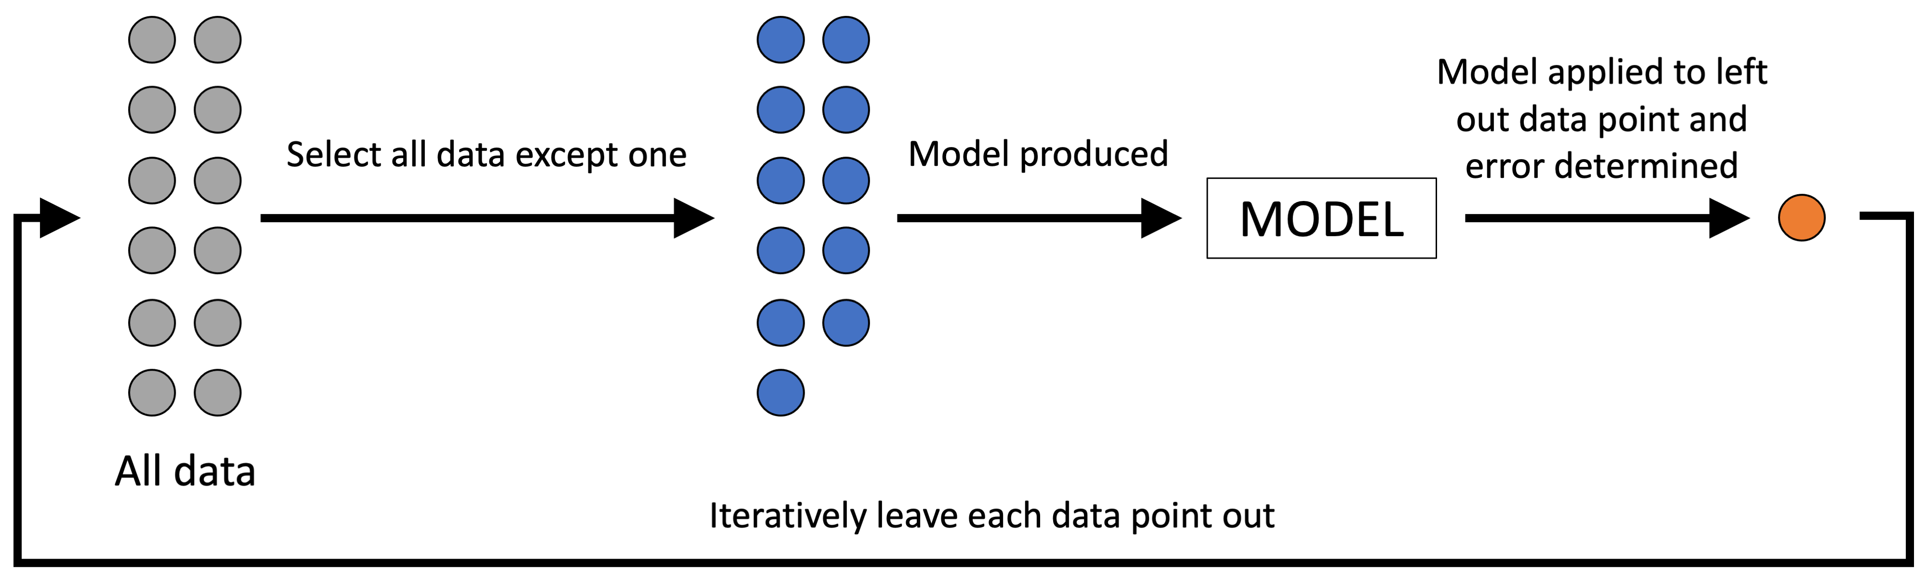
Notes:
Figure 9.15: Leave-one-out method to assess model predictivity.

Slide 17
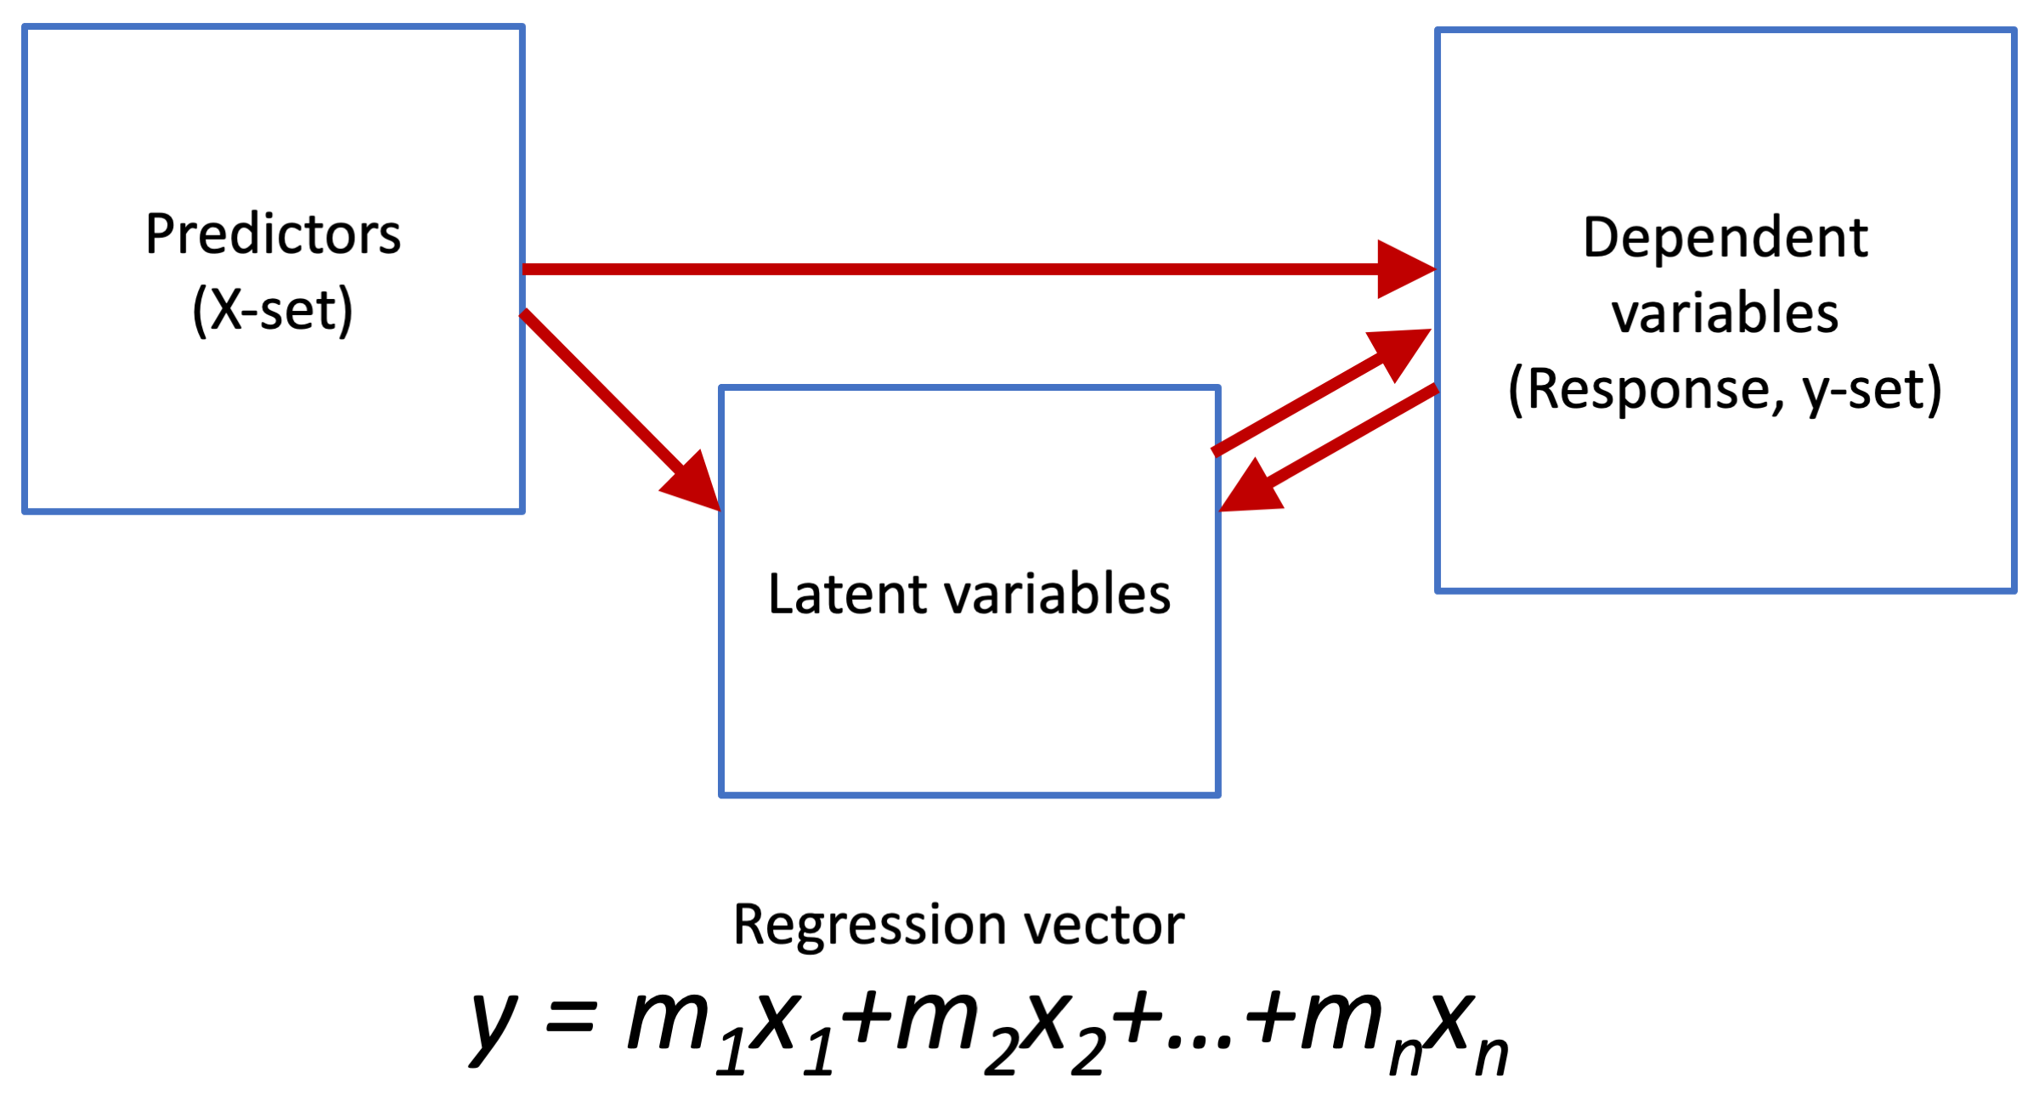
Notes:
Figure 9.16: Schematic depiction of PLS.

Slide 18
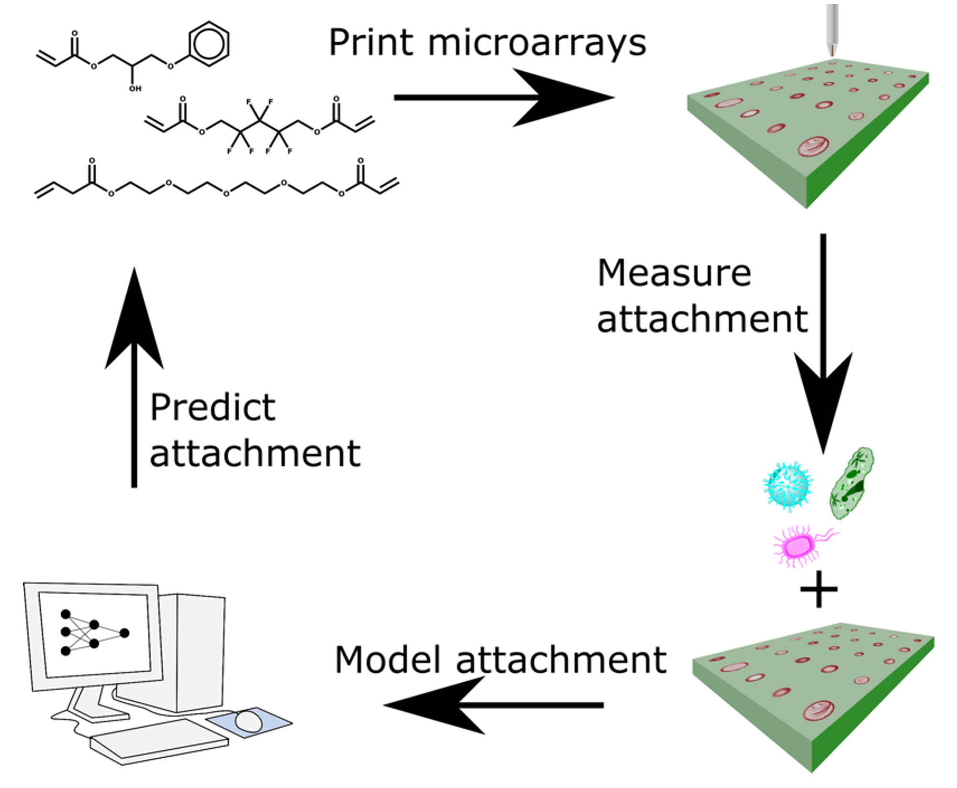
Notes:
Figure 9.17: The combined experimental and computational materials discovery loop.

Slide 19
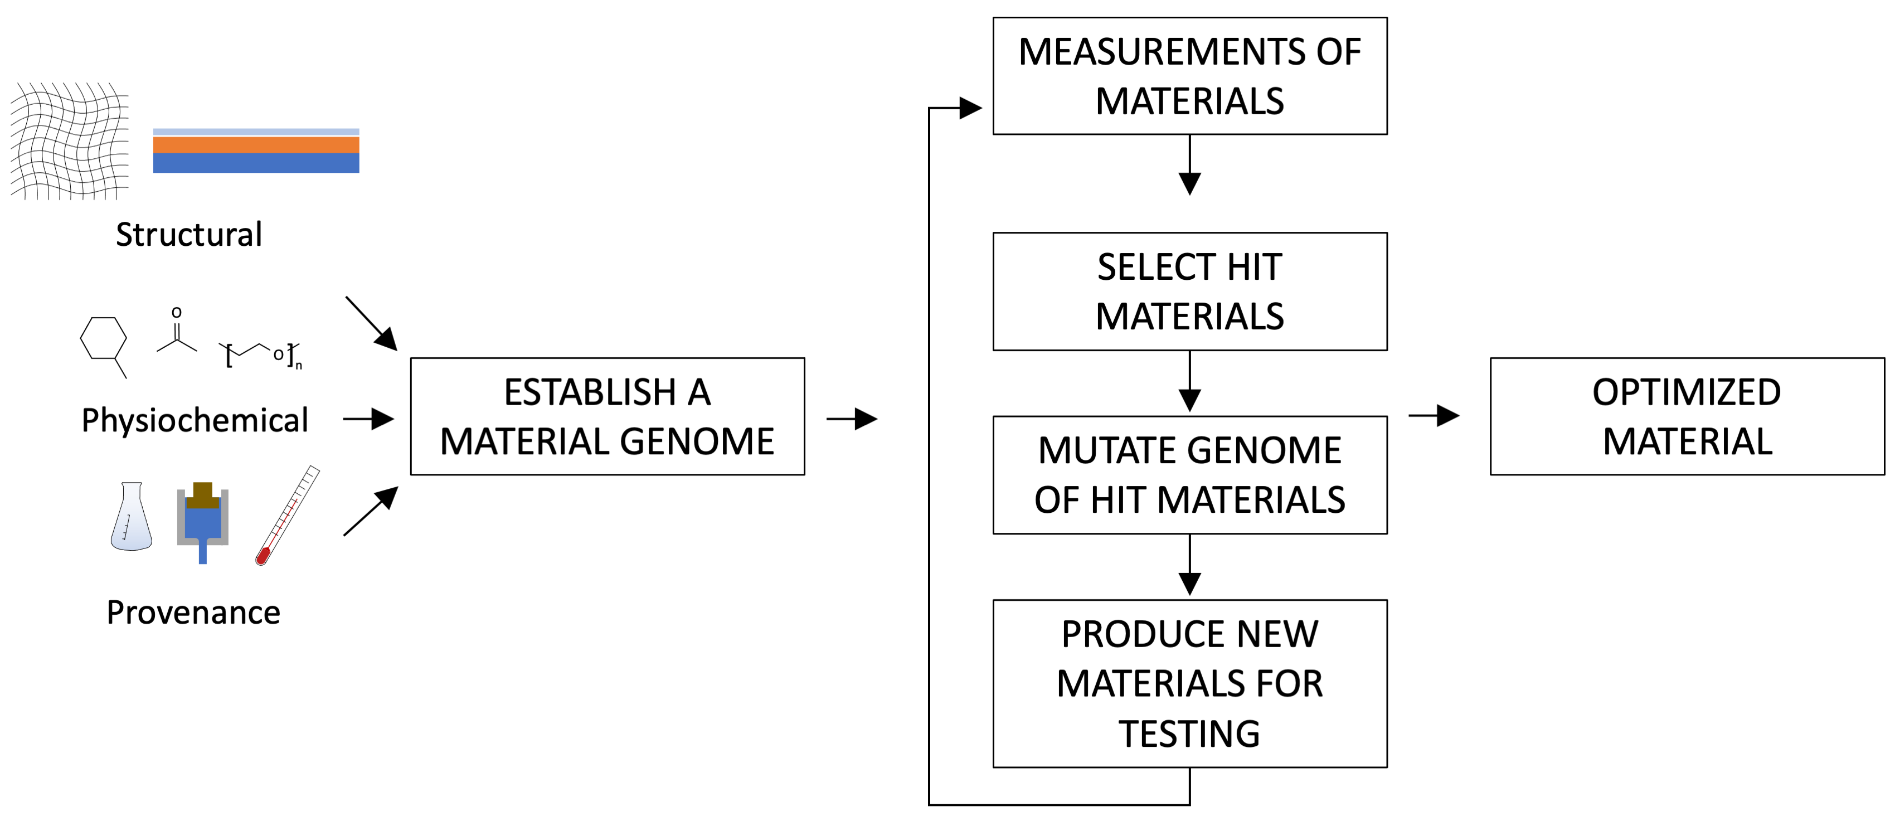
Notes:
Figure 9.18: The methodology for evolving materials computationally.

Slide 20
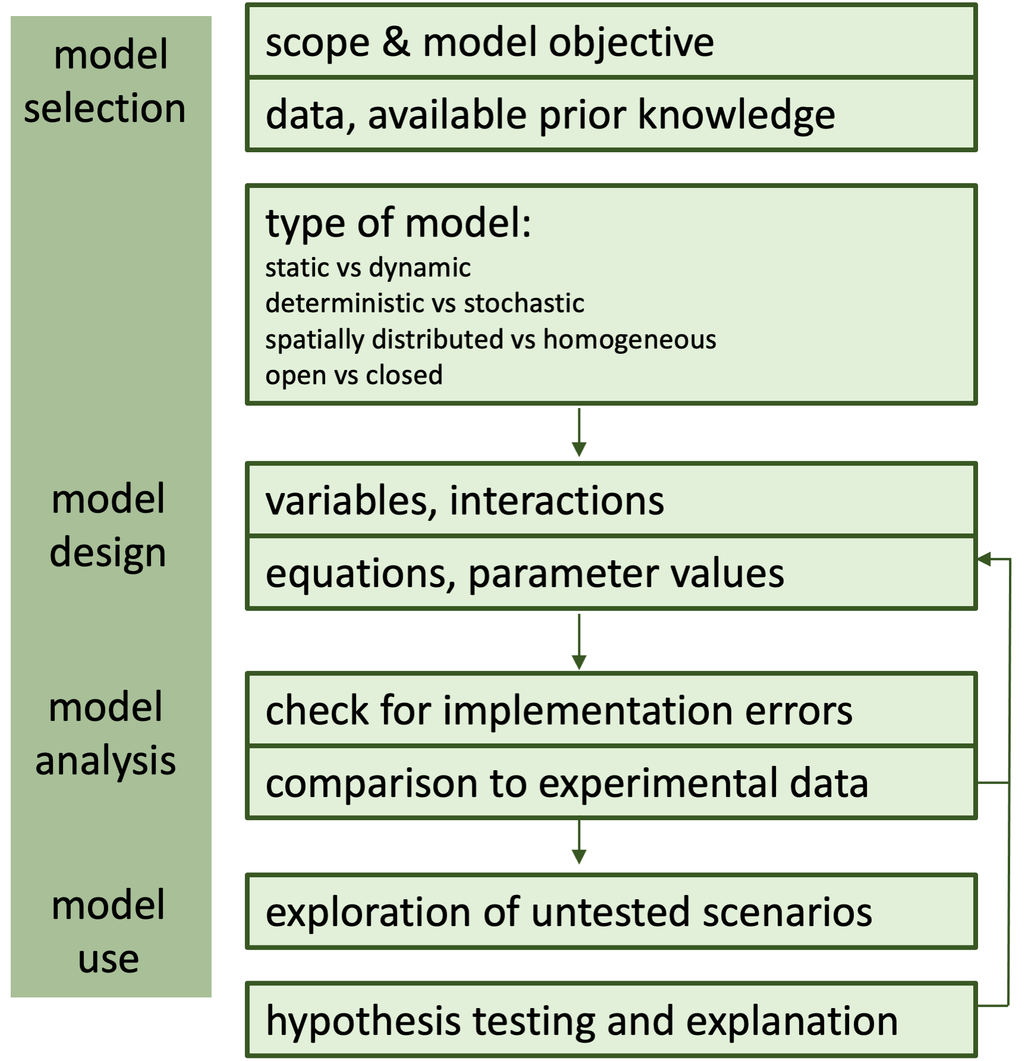
Notes:
Figure 9.19: Flow chart of the generic modelling process.
From Steps of modeling complex biological systems, Voit, E.O., Qi, Z. & Miller, G.W. 2008. Pharmacopsychiatry 41, S78-S84.

Slide 21
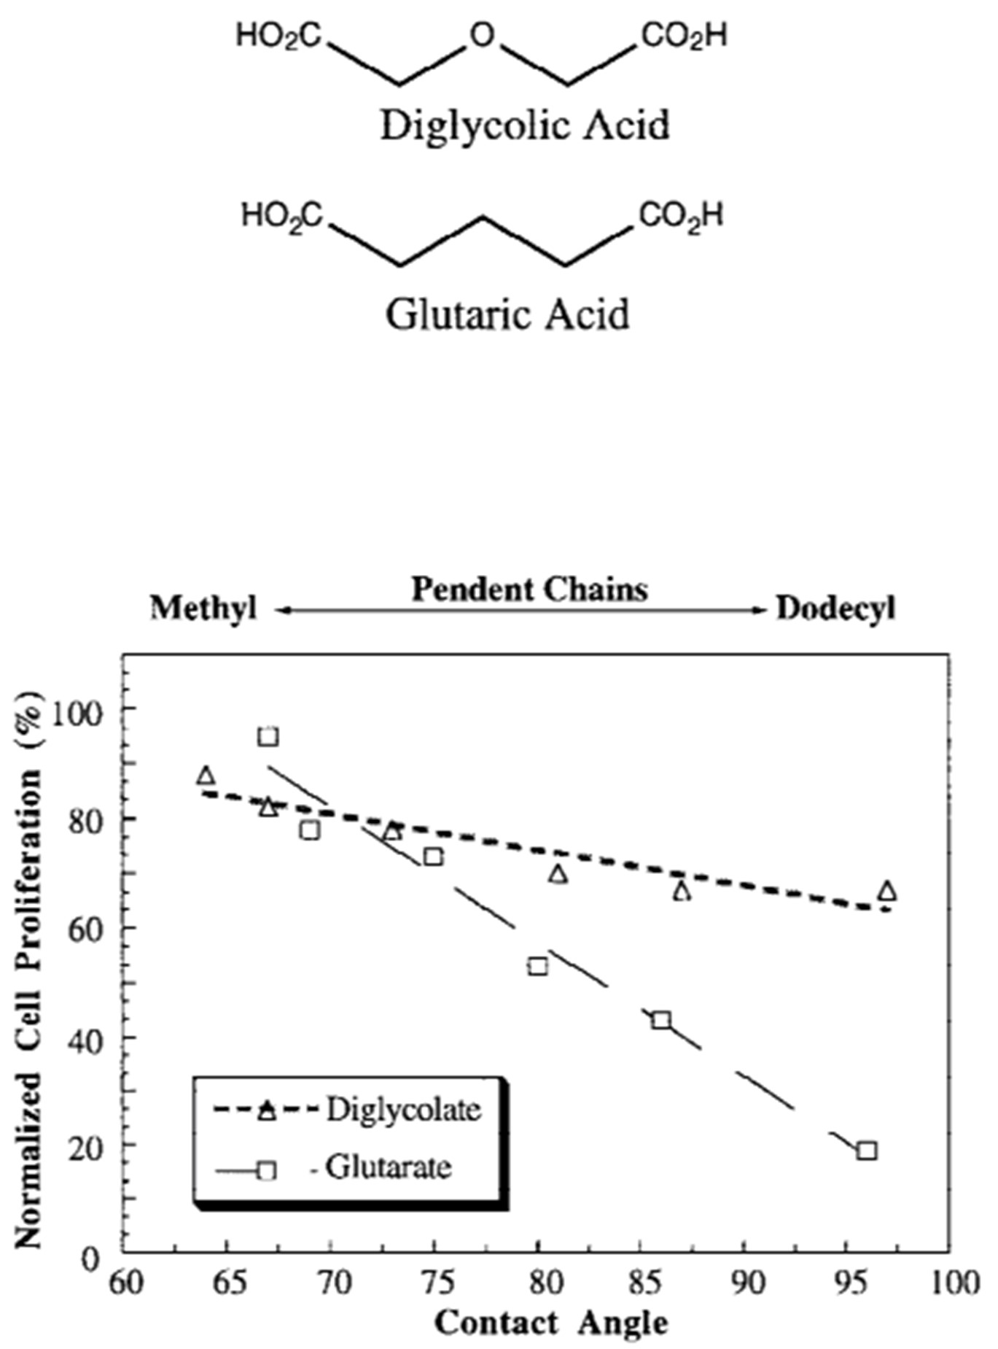
Notes:
Figure 9.20: Comparing the proliferation of fibroblasts with WCA – towards establishing a structure-function relationship.
From Structure-property correlations in a combinatorial library of degradable biomaterials, Brocchini et al., 1998. J. Biomed. Mater. Res. 42, 66-75.

Slide 22
Notes:
Figure 9.21: a) Process for developing and validating a predictive model. Data from hundreds of commercially available materials together with material properties are used to generate models that predict new untested materials which are synthesized and tested. This repeated cycle refines the theoretical model. b) Materials library screened including 12 monomers with different alpha values.
From Validating a Predictive Structure-Property Relationship by Discovery of Novel Polymers which Reduce Bacterial Biofilm Formation, Dundas et al., 2019. Adv. Mater. 1903513.

